Slide 1
How to Effectively Manage Your Facilities Using Sustainable Practices
by
Corey Lee Wilson
of
CLW Enterprises

Slide 2
Covered in this Presentation
Developing sustainable facility management practices
Being your organization’s sustainable facilities management champion
Developing, implementing, and measuring a Sustainable Facilities Management Plan (SFMP)

Slide 3
A Brief Introduction to Sustainable Facilities Management (SFM)
A sustainable facilities management (SFM) process optimizes financial, environmental and social factors in support of the primary purpose of the organization.
SFM is the ability to manage facilities and resources in a manner consistent with all that is "green" and "high-performance.”
The idea of sustainable facilities is not just about doing something that is environmentally or people-friendly.
It’s about that, but it’s also about making facilities last, performs at a level that meets the needs of the organization, and managed in a manner that is consistent with the mission, vision, and values of the organization.

Slide 4
The goal of the facility manager has always been to optimize performance. High-performance and green facility benchmarks consist of:
Green
and High Performance Characteristics
Energy efficiency
Conservative water use
Minimal waste production
Low reliance on natural resources
Low-carbon emissions
Healthier indoor environment
Productive workplaces
Commitment to net zero energy use

Slide 5
Why Use Sustainable Practices?
Corporate Social Responsibility (CSR)
The Triple Bottom Line (TBL)
High Performance and Green Facilities

Slide 6
As sustainability rises to the top of the list of priorities, so do CSR programs.
86 percent of the Standard & Poor's top ranked 100 companies have corporate sustainability websites.
CSR has become a matter of maintaining competitiveness
Simply stated, people would rather deal with companies who practice CSR.
FM’s should be CSR leaders and take a larger role in supporting them.
Corporate Social Responsibility (CSR)
CSR is meeting the environmental needs of the present while preserving the Environment for future generations.

Slide 7
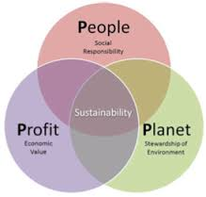
The Triple Bottom Line (TBL)
Profit is the traditional measure of economic performance – or the 'bottom line' of the profit and loss account.
People are the bottom line of a company's social contract - a measure in some shape or form of how socially responsible an organization has been throughout its operations.
Planet is the bottom line of the company's green and sustainability account - a measure of how environmentally responsible it has been.

Slide 8
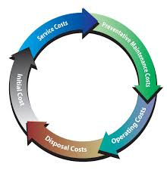
High Performance and Green Facilities
Properly maintained workplaces
Frees employees from distractions
So they concentrate on their jobs
And perform their work at a high level
Which attracts the best employees
And creates a significant competitive edge
Receiving a public perspective of being socially responsible
And saves on costs!

Slide 9
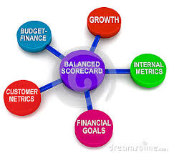
Developing a Sustainable Facility Management Plan (SFMP)
Fully understand the overall strategy of your organization.
Your organization's mission, vision, values and strategic objectives may impact how you approach facility management.
Alignment of facility management strategy with the overall strategy of the organization is vital.
The end goal of the SFMP is to enable the organization to accomplish its overall strategic objectives in a manner that supports its commitment to CSR.

Slide 10
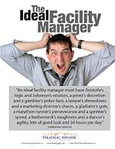
Alignment with the Organizational Strategy
FM organization's strategy aligns with the overall organizational strategy.
FM strategy must fully support each business unit's strategy.
Understand the organization's mission, vision and values which drive the organization's strategy.
Having this understanding will allow the facility manager to craft a supporting strategy.
The SFMP will be more readily accepted and approved because it is linked to satisfying the entire organization's requirements.

Slide 11
Preparing a SFM Strategy Plan
Any strategic plan should focus on the longer-term, big picture needs and vision of the organization.
It’s critical that the SFMP strategy aligns with the overall strategy of the organization.
The mission is why the strategy exists.
The vision is a picture of where the organization wants to be in the future.
From the mission and vision come the goals.
There is a strategy to developing the strategy.

Slide 12
4 Primary Goals of the SFM Strategy Plan
Understanding
Mission, vision, culture, core values and key stakeholders perspectives.
Analysis
Gap analysis and develop a plan to bridge the gap.
Planning
Turn gap analysis phase into a strategic SFMP with a business plan (business case) and present to management for approval.
Acting
Submit business case for review and approval.
Note: A SFMP is for strategic approval and the Business Case is for tactical implementation.

Slide 13
The Business Case
SMART goals that are Specific, Measurable, Achievable, Realistic and Timely.
Reasoning for the return on investment (ROI), total cost of ownership (TOC), and life-cycle costs (LCC) for the FMP strategy.
Approval to go forward with the strategy.
Management must understand the background and logic behind the strategy.
Management must be comfortable releasing the resources and preliminary funding.
Formulate opinion and decision primarily based on the executive summary.
The executive summary must be concise and impactful in ten minutes or less.
Must be credible, practical, feasible and accurate.
A successful business case needs the following:

Slide 14
SFMP Sponsor and Champion
The FM is in a good position to be the SFMP champion.
There could be other drivers and SFMP champions besides the FM.
In that case, the FM should make a case for active involvement in the process.
If organization is not driving the process, the FM is forced to take the lead as an insurgent.
Even in an insurgent role the facility manager can make a difference.
Keep sponsor well informed with regular updates.
The sponsor is one who can keep the effort at the forefront of the organization and continually emphasize its importance.

Slide 15
Implementing and Measuring the SFMP
The challenge of incorporating sustainable asset management practices.
Change is not easily accepted and "business as usual" seems to be the motto.
Sustainable asset management must become a part of the organizational culture.
Develop a change management strategy and communications plan to engage your workforce in sustainable facility management.

Slide 16
The SFMP Team
Success depends on team performance.
Meets all challenges to carrying out the strategy.
Strong leadership and team dynamics required.
Team member competencies and training.
Objectives must be set, responsibilities assigned, and performance measured.
A SFM strategy cannot be developed in a vacuum, nor can it be forced upon people.
It must be a collaborative effort by those who will be impacted by it.

Slide 17
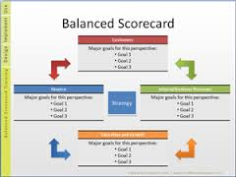
The Balanced Scorecard (BSC)
The BSC allows for the prioritization of initiatives based on cost, effectiveness, and any number of other Triple Bottom Line factors.
BSC acts as a framework for developing the right key performance indicators (KPIs) for monitoring and reporting the success of SFM efforts.
These KPIs serve as the guide for monitoring, changing, and improving the SFM efforts.
KPI’s also serve as the basis for reporting of facility related metrics that support the CSR goals and initiatives.
The BSC should be used to create a process for measuring and monitoring energy, carbon, water, resources use and workplace quality.

Slide 18
Managing and Operating the 8 Key Areas of Sustainable
Energy
Water
Materials and Resources
Workplace Management
Indoor Environmental Quality
Quality of Services
Waste
Site Impact
Each organizations SFMP’s is different, however, most if not all of their goals will focus on improving the following items:

Slide 19
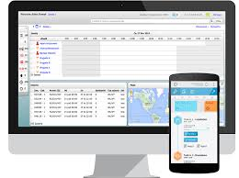
Performance Management and Communication Tools
WMS’s show energy, water and resource use, how you're consuming resources, and how well you’re managing comfort and safety in the workplace.
High performance facility organizations maximize the efficiency of their processes such as having an automated work management system in place.
They have formalized preventive and predictive maintenance programs and techniques.
They also have documented procedures in place like standard operating procedures (SOPs) outlined for high-performance operations and maintenance.
A work management system (WMS) provides a means of capturing work order / staff / space / asset / financial data to help make decisions regarding:

Slide 20
Most Commonly Used Work Management Systems
CMMS - Computerized maintenance management system
CAFM - Computer aided facility management
BAS - Building automation system
BIM - Building information modeling
IWMS - Integrated work management system
ERP - Enterprise resource planning
GIS - Geographical information system
DMS - Document management system
CPS - Capital planning system
The most commonly used work management systems follow and no SFMP should be without the first 2 items:

Slide 21
Conclusion
Join an IFMA chapter and take advantage of their SFM programs, webinars, articles, and white papers to enhance your SFM program. Go to www.ifma.org and to www.ifmaiechapter.org for more info.
Earn the Sustainability Facility Professional (SFP), Facility Management Professional (FMP), or Certified Facility Manager (CFM) credentials from IFMA. Follow this link at http://www.ifmacredentials.org/ for more info.
Utilize and contract with an IFMA consultant for SFM development.
Get your existing building LEED EBOM certified.
How can you further develop these skills, develop your own SFMP, and implement green and high performance facilities?

Slide 22
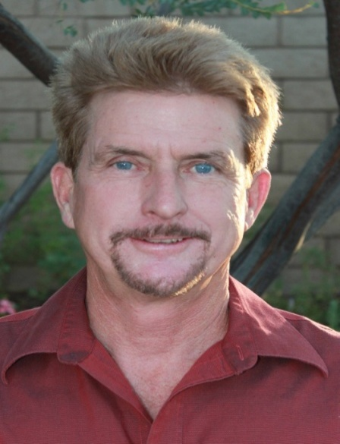
Questions, Conclusion and Contact Info
CLW Enterprises is providing free of charge a pdf guidebook on this topic. The How to Effectively Manage Your Facilities Using Sustainable Practices pdf guidebook has more information than presented today, plus it has all of the information at your fingertips, including the links for those resources noted and additional ones as well.
If you would like to receive one, please let me know today or go to my website at www.CLW-Enterprises.com where you can request a free copy. Also provided for free are my How to Get Your Existing Building LEED Certified and How to Manage California’s CALGreen Code, Zero Net Energy & AB 1103 Requirements pdf guidebooks.
For more information about Sustainable Facility Practices, Business Cases, and SFMP’s and the services to complete them, please contact Corey Lee Wilson at CLW Enterprises at (951) 415-3002 or email me at CLWEnterprises@att.net or visit my website at www.CLW-Enteprises.com.
Content for this presentation borrowed from the book Sustainable Facility Management: The Facility Manager’s Guide to Optimizing Building Performance by Chris Hodges and Mark Sekula.
Corey Lee Wilson
(BS Economics, SBE, Member of CMAA, IFMA, DBIA, BIA and a CMAA CCM, LEED AP, and IFMA FMP)

